Slide 1
STAT 7900: Special Topic:
Causal Analysis
Instructor
Dhrubajyoti Ghosh
KENNESAW STATE UNIVERSITY
STAT 7900

Slide 2
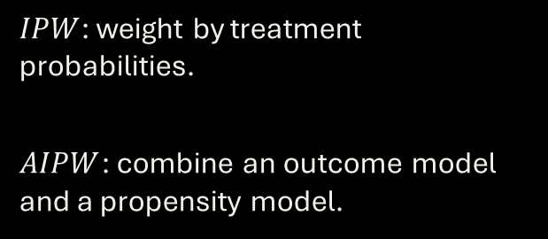
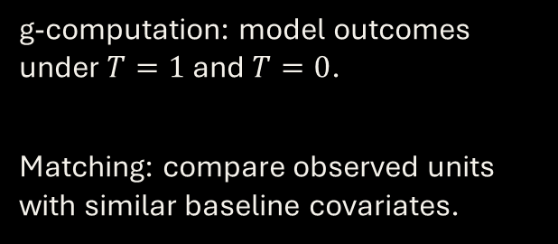
Recap: One Target, Four Approaches
g-computation and matching
IPW and AIPW
g-computation: model outcomes under $T=1$ and $T=0$.
Matching: compare observed units with similar baseline covariates.
$IPW$: weight by treatment probabilities.
$AIPW$: combine an outcome model and a propensity model.
Each method needs a credible identification strategy.

Slide 3
Recap: Four Estimation Strategies
g-computation
IPW
AIPW
Predict both potential-outcome means and average their difference.
Reweight observed outcomes to create a pseudo-population.
Combine predictions with inverse-weighted residual corrections.
AIPW is doubly robust to either nuisance model being correctly specified, not to unmeasured confounding.

Slide 4
Recap: Identification versus Estimation
Identification
Estimation
Consistency, exchangeability, positivity and appropriate interference assumptions connect data to causal effects.
Regression, matching, weighting, doubly robust estimators and forests estimate effects after identification.
More flexible prediction cannot, by itself, cure unmeasured confounding.

Slide 5
Recap: ATE and CATE
$ATE = E[Y(1) − Y(0)]$vs. $CATE(x) = E[Y(1) − Y(0) | X=x]$
ATE asks: what is the average effect in the population?
CATE asks: how does the average effect vary across baseline characteristics X?
CATE is a subgroup conditional mean effect, not an observed individual treatment effect.

Slide 6
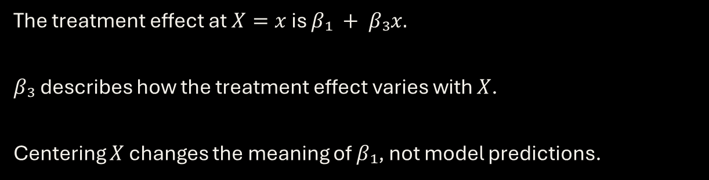
Recap: Interaction Models
$$E[Y | T,X] = β₀ + β₁T + β₂X + β₃(T × X)$$
The treatment effect at $X=x$ is $β₁ + β₃x.$
$β₃$ describes how the treatment effect varies with $X$.
Centering $X$ changes the meaning of $β₁$, not model predictions.

Slide 7
Recap: Three Meta-Learners
S-learner
T-learner
X-learner
Fit one outcome model with T and X; predict two treatment worlds.
Fit separate outcome models for treated and controls; subtract predictions.
Impute treatment-effect signals, fit effect models and combine them.
These are modeling strategies, not different causal identification assumptions.

Slide 8
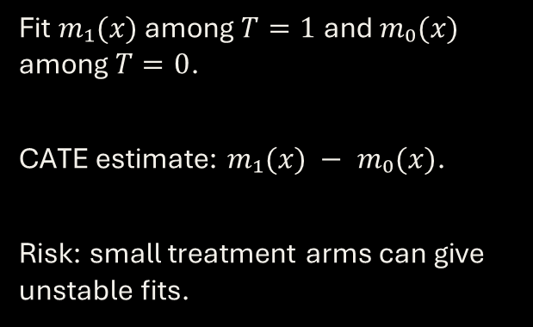
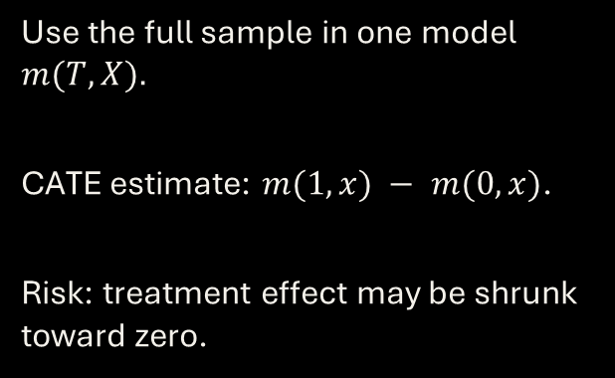
Recap: S-Learner and T-Learner
S-learner
T-learner
Use the full sample in one model $m(T,X).$
CATE estimate: $m(1,x) − m(0,x)$.
Risk: treatment effect may be shrunk toward zero.
Fit $m₁(x)$ among $T=1$ and $m₀(x)$ among $T=0$.
CATE estimate: $m₁(x) − m₀(x)$.
Risk: small treatment arms can give unstable fits.
Both can use linear models, GAMs, random forests or other outcome learners.

Slide 9
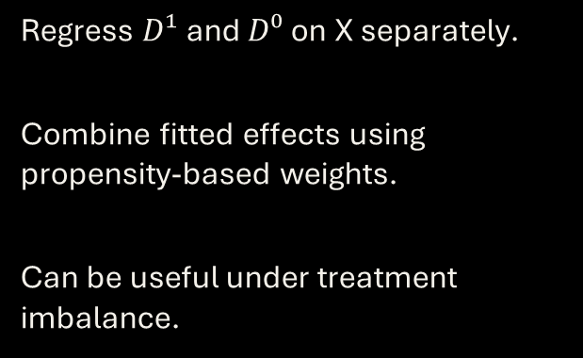
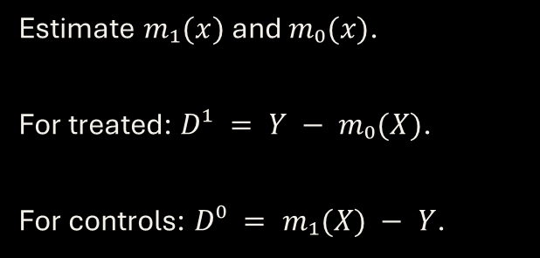
Recap: Why the X-Learner Is Different
First stage: outcome models
Second stage: effect models
Estimate $m₁(x)$ and $m₀(x)$.
For treated: $D¹ = Y − m₀(X)$.
For controls: $D⁰ = m₁(X) − Y$.
Regress $D¹$ and $D⁰$ on X separately.
Combine fitted effects using propensity-based weights.
Can be useful under treatment imbalance.
Pseudo-effects are constructed outcomes, not individually observed causal effects.

Slide 10
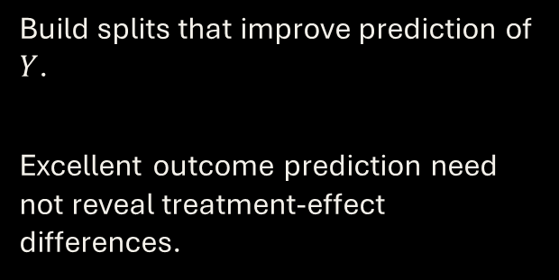
Recap: Causal Forest versus Ordinary Forest
Ordinary random forest
Causal forest
Build splits that improve prediction of $Y$.
Excellent outcome prediction need not reveal treatment-effect differences.
Build splits aimed at treatment-effect heterogeneity.
Estimate local treatment effects using nearby observations.

Slide 11
Recap: Honesty and Cross-Fitting
Honest forests
Cross-fitting
Use different subsamples to select splits and estimate effects.
Reduce adaptive overfitting and estimation bias.
Fit nuisance models on other folds.
Generate out-of-fold predictions for the evaluation observations.
Sample splitting helps estimation validity; it does not remove unmeasured confounding.

Slide 12
Recap: How to Evaluate HTE
Calibration
Subgroup comparisons
Uncertainty
Do larger predicted effects correspond to larger observed causal contrasts?
Report intervals, sampling variability and multiple-testing concerns.
Compare groups in independent data using valid causal estimators.
Variation in predicted CATEs alone is not proof of real treatment-effect heterogeneity.

Slide 13


Slide 14
Recap: The Question We Face Today
What if an important confounder $U$ was never measured?
Matching, IPW and AIPW adjust for observed X.
HTE learners and causal forests estimate effects conditional on X.
None automatically eliminates bias from an unobserved common cause U.
Today: sensitivity analysis quantifies fragility; instrumental variables use a different design.

Slide 15
A Concrete Reason to Worry: Missing Motivation
Example: job-training program
What the dataset records
Some participants enroll because they are especially motivated.
Motivation may also improve their earnings even without training.
Treatment, age, education, prior earnings, and later earnings.
But motivation was not recorded. Participants and nonparticipants can still differ.
Discussion: if we exactly balance age and prior earnings, is the comparison necessarily causal?

Slide 16
Estimation Is Not Identification
Estimation problem
Identification problem
Given an identified causal effect, how can we estimate it reliably?
Regression, IPW, AIPW, and forests address aspects of this problem.
Can observed outcomes reveal the causal effect at all?
If U affects both T and Y, adjusting only for measured X may not identify the effect.
A more powerful prediction algorithm cannot reconstruct an unobserved confounder automatically.

Slide 17
Challenge the Assumption
Question 1: What could go wrong?
Question 2: How fragile is the conclusion?
An unmeasured common cause U makes treated and control groups incomparable even after adjustment.
We can examine its causal diagram and possible bias.
Instead of assuming U has no influence, assess how strong hidden confounding would need to be to overturn a result.
Tools: E-values and Rosenbaum bounds.
Sensitivity analysis tests robustness to specified hidden bias; it does not eliminate the bias.

Slide 18
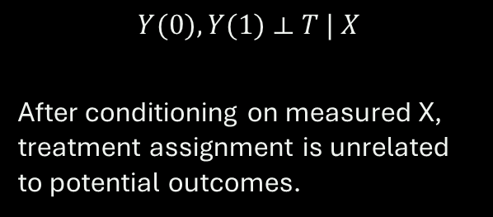
When the Ignorability Assumption Fails
What we have assumed
The difficult possibility
A variable U influences treatment and the outcome, but U was never recorded.
Conditioning on X may no longer remove confounding.
$$Y(0), Y(1) ⟂ T | X$$
After conditioning on measured X, treatment assignment is unrelated to potential outcomes.
More sophisticated estimation does not automatically repair failed identification.

Slide 19


A Hidden Common Cause: The DAG
Hidden U
Treatment T
Outcome Y
$U → T$: influences assignment
$U → Y$: predicts outcome
Open backdoor path: $T ← U → Y$

Slide 20
Example: Treatment Selection by Severity
Clinical setting
What goes wrong
Patients with more severe illness are more likely to receive an aggressive treatment.
Severity also increases the probability of a poor outcome.
Suppose the recorded data include age and sex, but not severity.
Comparing treated and untreated patients can make an effective therapy appear harmful.
The apparent treatment association mixes treatment effects with selection effects.

Slide 21
Why Familiar Estimators Cannot Fix Hidden U
Matching / IPW
g-computation / AIPW
Balance measured X; U can remain imbalanced.
Model outcome and treatment using measured X, not unobserved U.
S/T/X-learners
Causal forests
Flexible response models do not guarantee exchangeability.
Better CATE estimation does not identify effects without a valid design.
Bias from unmeasured confounding is an identification issue, not merely prediction error.

Slide 22

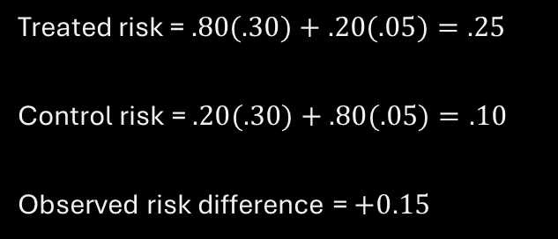
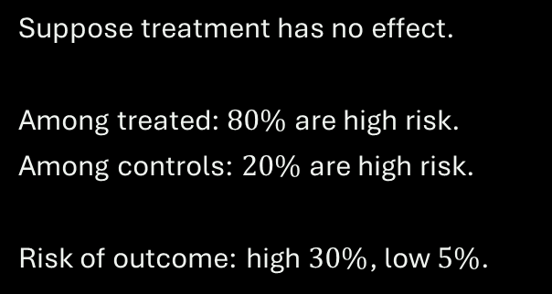
Numerical Illustration: A Spurious Effect
True causal effect $= 0$
Observed comparison
Suppose treatment has no effect.
Among treated: $80\%$are high risk.
Among controls: $20\%$ are high risk.
Risk of outcome: high $30\%$, low $5\%$.
Treated risk = $.80(.30)+.20(.05)=.25$
Control risk = $.20(.30)+.80(.05)=.10$
Observed risk difference = $+0.15$
A 15-percentage-point observed gap can exist even when treatment changes nothing.

Slide 23
What Is Sensitivity Analysis?
Conventional analysis
Sensitivity analysis
Estimate the treatment effect under assumptions about measured confounders and identification.
Vary assumptions about unmeasured confounding; examine how much conclusions would change.
It tests robustness to specified departures from assumptions; it does not verify them.

Slide 24
The Key Question: How Much Hidden Bias?
Weak U
Moderate U
Strong U
Small imbalance and weak outcome association.
Conclusion may persist.
Can attenuate the estimated effect.
Intervals may include null.
May overturn the estimated sign or statistical conclusion.
A tipping point is the strength of U at which the conclusion changes.

Slide 25
Different Sensitivity Tools Answer Different Questions
E-values
Rosenbaum bounds
How strongly must U relate to exposure and outcome (RR scale)?
How much hidden treatment-assignment bias can matched comparisons tolerate?
Quantitative bias analysis
Alternative identification
Choose confounder prevalence and outcome associations; compute corrected estimates.
Negative controls, IVs, and designs use additional assumptions and information.

Slide 26
E-Values: Intuition
A robustness summary on the risk-ratio scale
For an observed exposure–outcome risk ratio, the E-value summarizes the minimum association strength an unmeasured confounder would need with BOTH exposure and outcome, conditional on measured X, to explain away the association.
Larger E-values generally indicate greater robustness to this specific kind of confounding.
E-values do NOT measure how likely the hidden confounder is to exist.

Slide 27
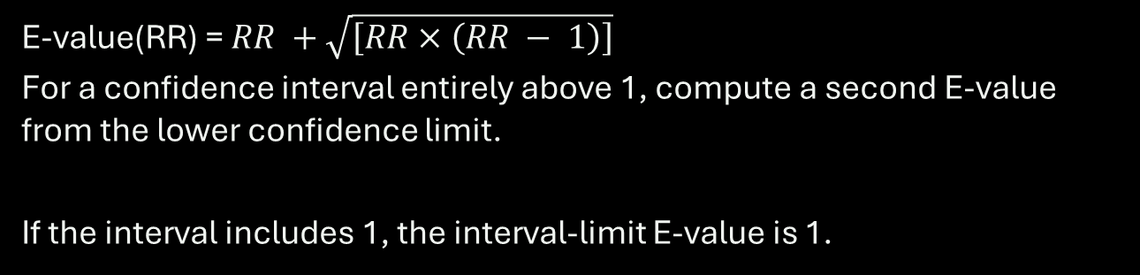
E-Value Formula: Risk Ratio Above 1
For $RR ≥ 1$ (Risk Ratio (RR) – Risk in treatment group $/$ Risk in Control Group)
E-value(RR) = $RR +\sqrt{\left[RR × \left(RR − 1\right)\right]}$
For a confidence interval entirely above 1, compute a second E-value from the lower confidence limit.
If the interval includes 1, the interval-limit E-value is 1.
Use the RR scale. OR / HR and continuous outcomes require appropriate care or conversion.

Slide 28
Worked E-Value Example
Suppose a study reports
Calculate
Adjusted risk ratio = 2.00
95% confidence interval: [1.30, 3.00]
Outcome: a binary adverse event.
Point: 2 + √[2(2−1)] = 3.41
CI limit: 1.3 + √[1.3(.3)] = 1.92
E-values: point 3.41; CI 1.92
The CI-bound E-value is often more relevant to whether the result remains statistically distinguishable from null.

Slide 29
R Code: Compute E-Values
evalue_rr <- function(rr) {
r <- ifelse(rr < 1, 1 / rr, rr)
r + sqrt(r * (r - 1))
}
rr <- 2.00
ci <- c(1.30, 3.00)
evalue_rr(rr) # 3.414
evalue_rr(ci[1]) # 1.924
Important
This code illustrates risk ratios and a CI above 1.
For ratios below 1, use the reciprocal and the CI limit nearest 1.
Not a substitute for judging U’s plausibility.

Slide 30
What E-Values Do, and Do Not Establish
Useful
Limitations
A compact numerical benchmark.
Can compare sensitivity against measured covariate associations.
Simple to calculate and report.
Cannot prove no confounding.
Does not establish the existence of a specific U.
Does not repair measurement error, selection bias, or model/design flaws.
Wrong to say: “an E-value of 3.4 means the causal effect is proven.”

Slide 31
Rosenbaum Bounds: Motivation
After matching
Rosenbaum sensitivity analysis
Two patients appear comparable on observed X.
But one may still have a higher probability of receiving treatment because of unmeasured U.
Ask how large the hidden difference in treatment odds could be before a matched-study significance conclusion becomes fragile.
Rosenbaum bounds focus on sensitivity of matched comparisons to hidden assignment bias.

Slide 32
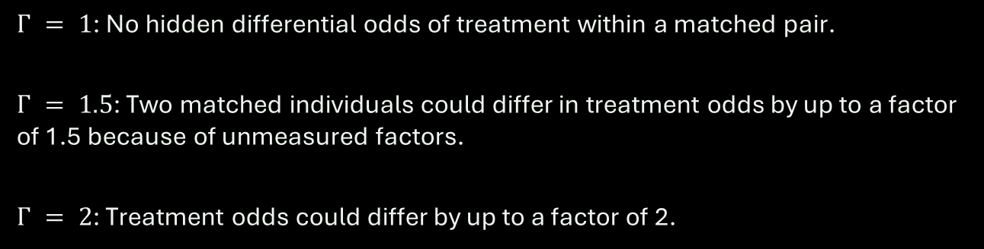
Rosenbaum’s $Γ$: Hidden Assignment Bias
Interpretation of Γ
$Γ = 1$: No hidden differential odds of treatment within a matched pair.
$Γ = 1.5$: Two matched individuals could differ in treatment odds by up to a factor of 1.5 because of unmeasured factors.
$Γ = 2$: Treatment odds could differ by up to a factor of 2.
$Γ$ is an odds-ratio bound for assignment, not an outcome risk ratio or bias percentage.

Slide 33
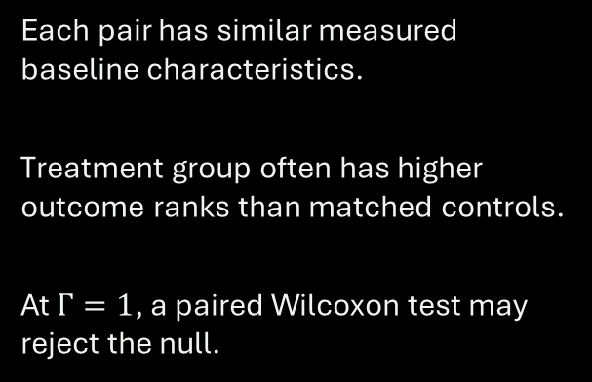
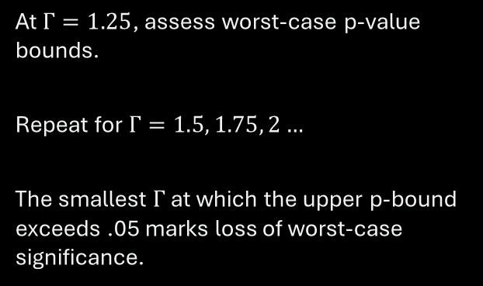
Worked Example: Matched Pairs and Γ
Imagine 10 matched pairs
Increase hidden bias
Each pair has similar measured baseline characteristics.
Treatment group often has higher outcome ranks than matched controls.
At $Γ=1$, a paired Wilcoxon test may reject the null.
At $Γ=1.25$, assess worst-case p-value bounds.
Repeat for $Γ=1.5, 1.75, 2…$
The smallest $Γ$ at which the upper p-bound exceeds .05 marks loss of worst-case significance.
Illustrative procedure; the tipping $Γ$ must be computed from the actual matched outcomes.

Slide 34
R Code: Rosenbaum Bounds for Matched Pairs
# install.packages("rbounds")
library(rbounds)
# Illustrative paired outcomes
trt <- c(12, 15, 11, 20, 18, 19,
16, 14, 13, 17)
ctrl <- c( 8, 10, 9, 12, 13, 14,
11, 10, 12, 13)
psens(trt, ctrl, Gamma = 2,
GammaInc = 0.25)
How to read output
Check upper and lower p-value bounds over Γ.
If upper bound becomes > .05, worst-case statistical significance is no longer guaranteed.
Input vectors must be correctly paired.

Slide 35
Matched Pairs: Hidden-Bias Sensitivity in Numbers
Γ (assignment odds bound)
Worst-case upper p-value
1.00
0.0010
1.25
0.0028
1.50
0.0060
1.75
0.0109
2.00
0.0173
2.50
0.0346
3.00
0.0563
Exact upper p-bound for a one-sided sign test with 10 positive pair differences.

Slide 36
Putting the Results Into an Applied Report
What to report
What to conclude
Effect estimand, estimate, and uncertainty.
Measured adjustment set and balance diagnostics.
Chosen sensitivity method and assumptions.
Numerical sensitivity parameter(s).
Whether conclusions are robust within a stated range.
What plausible hidden confounders might look like.
Where conclusions change.
Avoid claims that the analysis rules out all bias.
Sensitivity analysis supplements, rather than replaces, research-design credibility.

Slide 37
Summary and Transition to Instrumental Variables
Today’s message
Next: Instrumental Variables
Unobserved U can invalidate exchangeability.
Sensitivity analysis examines robustness to specified hidden confounding.
E-values and Rosenbaum bounds answer different questions.
Can we identify an effect when exchangeability fails?
We will need new assumptions: relevance, exclusion, independence, and often monotonicity for LATE.
Sensitivity: “How fragile?” | IV: “Can a new design identify an effect?”

Slide 38
From Sensitivity Analysis to Instrumental Variables
Sensitivity analysis
Instrumental variables
How strong must hidden confounding be to change our conclusion?
Can extra design information identify a causal effect despite hidden confounding?
Sensitivity describes fragility; IV changes the identifying assumptions.

Slide 39
Instrumental Variables: The Causal Structure
Z
T
Y
U
Relevance: $Z → T$ | Exclusion: no direct $Z → Y$ | Independence: no $Z−U association$
A valid instrument moves treatment without an independent route to the outcome.

Slide 40
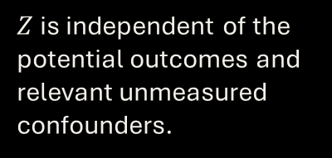
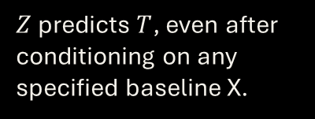
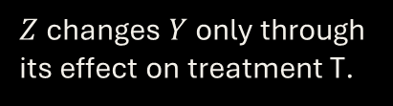
Three Core IV Assumptions
1. Relevance
2. Independence
3. Exclusion
$Z$ predicts $T$, even after conditioning on any specified baseline X.
$Z$ is independent of the potential outcomes and relevant unmeasured confounders.
$Z$ changes $Y$ only through its effect on treatment T.
The assumptions are substantive design claims, not guaranteed by a fitted model.

Slide 41
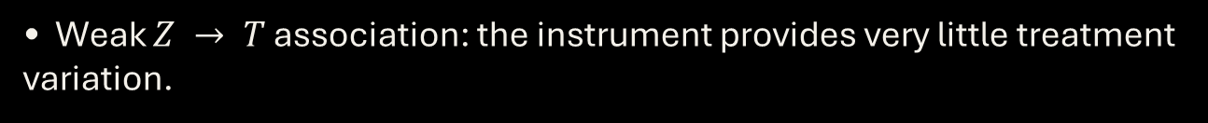
IV Assumptions: What Could Go Wrong?
• Weak $Z → T$ association: the instrument provides very little treatment variation.
$• Z → Y$ direct effect: exclusion restriction is violated.
• $U → Z$ association: independence fails.
• A statistically strong first stage does not validate exclusion.
Always draw the DAG and explain how the instrument was generated.

Slide 42
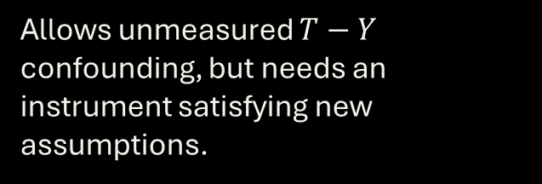
How IV Differs from Covariate Adjustment
Matching / IPW / AIPW
IV
Require exchangeability after conditioning on measured X.
Allows unmeasured $T−Y$ confounding, but needs an instrument satisfying new assumptions.
IV is not a universally safer estimator: its assumptions can be harder to defend.

Slide 43
Before Estimation: Four Questions
• What intervention and causal effect do we care about?
• Why should Z change treatment?
• Why is Z not connected to hidden causes of Y?
• Could Z influence Y through any pathway other than T?
Only then compute the IV estimator.

Slide 44
A Proposed IV: Physician Prescribing Preference
Clinical question
Candidate instrument
Does receiving Drug A rather than Drug B improve recovery?
Patients with worse underlying severity U may be more likely to receive A.
Z: physician prescribing preference
T: received Drug A
Y: recovery
U: hidden disease severity
Could physician quality or patient sorting violate independence or exclusion?

Slide 45
The Key Intuition: Instrument-Induced Variation
Observed T differences
Z-induced T differences
Treatment selection reflects both Z and hidden factors U.
Compare the change in outcomes associated with changes in Z.
IV isolates a particular source of variation in treatment.

Slide 46
The First Stage: Instrument $→$ Treatment
$$ΔT = E[T | Z = 1] − E[T | Z = 0]$$
• The first stage measures how strongly Z changes treatment.
• For binary T, $ΔT$ is a difference in treatment probabilities.
A near-zero ΔT makes the Wald ratio unstable.

Slide 47
The Reduced Form: Instrument → Outcome
$$ΔY = E[Y | Z = 1] − E[Y | Z = 0]$$
• This is the observed difference in Y between instrument groups.
• Under IV assumptions, the effect is transmitted through treatment.
The reduced form alone is not necessarily the treatment effect.

Slide 48
The Wald Estimator: A Ratio of Differences
IV effect = $ΔY / ΔT$
• Numerator: instrument–outcome association.
• Denominator: instrument–treatment association.
• Requires a nonzero first stage and credible IV assumptions.
With binary Z and T plus monotonicity, this identifies LATE.

Slide 49
Numerical Example: Encouragement to Attend Training
Instrument group
P(Training = 1)
Mean earnings
Z = 1: encouraged
0.70
$45,000
Z = 0: not encouraged
0.30
$41,000
First stage = 0.40; reduced form = $4,000; Wald = $10,000.

Slide 50
Calculate the Wald Estimate Step by Step
Wald = ($45,000 − $41,000) / (0.70 − 0.30)
• Reduced-form difference = $4,000.
• First-stage difference = 0.40.
• IV estimate = $10,000 per additional training participation.
Under LATE assumptions, interpret this as an effect for compliers.

Slide 51
Why Does Dividing Make Sense?
Step 1: shift Z
Step 2: observe Y
Step 3: rescale
Encouragement increases training by 40 percentage points.
The encouraged group earns $4,000 more on average.
$4,000 / 0.40 = $10,000 per induced participant.
The ratio translates the effect of encouragement into an effect of training.

Slide 52
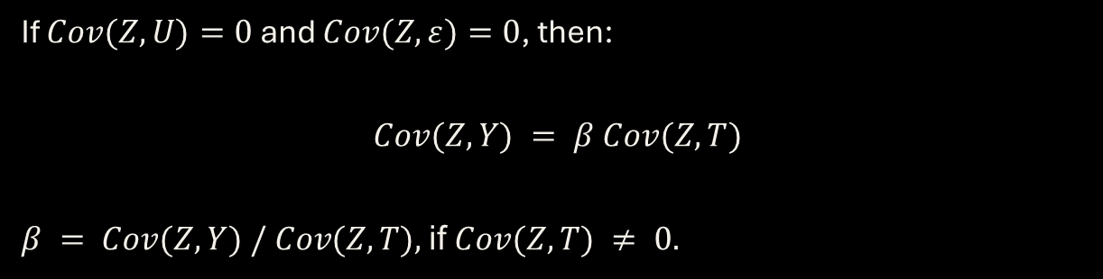
Why Does the IV Ratio Work?
$$Y = βT + γU + ε$$
If $Cov(Z,U)=0$ and $Cov(Z,ε)=0$, then:
$$Cov(Z,Y) = β Cov(Z,T)$$
$β = Cov(Z,Y) / Cov(Z,T),$if$Cov(Z,T) ≠ 0.$
This derivation assumes a constant structural treatment effect β.

Slide 53
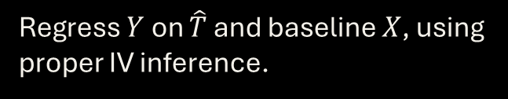
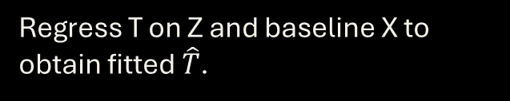
Two-Stage Least Squares (2SLS)
Stage 1: predict treatment
Stage 2: estimate outcome
Regress T on Z and baseline X to obtain fitted $\hat{T}$.
Regress $Y$ on $\hat{T}$ and baseline $X$, using proper IV inference.
Do not use ordinary second-stage lm() standard errors; use an IV routine.

Slide 54
2SLS with Baseline Covariates
$$T = α₀ + α₁Z + αᵀX + error$$
• Stage 1 obtains fitted treatment $\hat{T}$ from Z and X.
• Stage 2 uses instrument-generated variation in T to estimate its effect on Y.
• With constant linear effects and valid instruments, 2SLS targets that coefficient.
For heterogeneous effects, interpretation needs additional care.

Slide 55
Does IV Identify the Population ATE?
ATE
LATE
Average causal effect across everyone in the target population.
Average causal effect among people whose treatment is changed by the instrument.
A binary-instrument Wald ratio usually identifies LATE, not ATE.

Slide 56
Four Types of People (Binary Z and T)
Compliers
Always-takers
Never-takers
Take treatment if Z = 1, not if Z = 0.
Take treatment regardless of Z.
Never take treatment regardless of Z.
Defiers do the opposite of Z; monotonicity rules them out.

Slide 57
Monotonicity and the Compliance Types
$T(1) ≥ T(0)$for every person
• T(z): treatment received if the instrument were set to z.
• No one is discouraged into the opposite treatment direction.
• This is an assumption; data alone cannot establish it.
For a binary treatment and instrument, monotonicity excludes defiers.

Slide 58
Local Average Treatment Effect (LATE)
$$LATE = E[Y(1) − Y(0) | complier]$$
• Compliers are defined by their potential treatment responses to Z.
• LATE can differ from the ATE if effects vary across people.
• External validity depends on who the compliers are.
Always identify whose causal effect the instrument estimates.

Slide 59
ATE, ATT, and LATE: Not the Same Population
ATE
ATT
LATE
Everyone in the target population.
Those who actually received treatment.
Those whose treatment choice responds to Z.
Explain the estimand before interpreting the sign or magnitude.

Slide 60
Weak Instruments: Why First Stage Matters
Problem
Consequence
Practice
If Z barely changes T, the denominator of the Wald estimator is near zero.
Large uncertainty, unstable estimates, and unreliable usual approximations.
Inspect the first stage; consider weak-IV-robust intervals and tests.
Do not treat a first-stage F-statistic threshold as a universal guarantee.

Slide 61
Applied Example: Simulate a Confounded Setting
R workflow
What to notice
set.seed(7900)
n <- 1500
Z <- rbinom(n, 1, 0.5)
U <- rnorm(n)
T <- 0.8 * Z + U + rnorm(n)
Y <- 3 * T + 2 * U + rnorm(n)
Z is randomized.
U affects both treatment and outcome.
The true treatment coefficient is 3.

Slide 62
Why Ordinary Least Squares Is Biased
R workflow
What to notice
d <- data.frame(Y, T, Z)
fit_ols <- lm(Y ~ T, data = d)
summary(fit_ols)
U is missing from the fitted regression.
OLS mixes the treatment effect with confounding.
What direction should bias have?

Slide 63
Estimate the First Stage and Reduced Form
R workflow
What to notice
first <- lm(T ~ Z, data = d)
reduced <- lm(Y ~ Z, data = d)
coef(first)["Z"]
coef(reduced)["Z"]
coef(reduced)["Z"] / coef(first)["Z"]
The ratio reconstructs the Wald estimate in a just-identified linear setting.
First stage should be clearly nonzero.

Slide 64
Fit 2SLS with a Dedicated IV Routine
R workflow
What to notice
# install.packages("AER")
library(AER)
fit_iv <- ivreg(Y ~ T | Z, data = d)
summary(fit_iv, diagnostics = TRUE)
confint(fit_iv)
2SLS uses Z as the instrument for endogenous T.
Inspect IV coefficient, SE, confidence interval, and first-stage diagnostics.

Slide 65
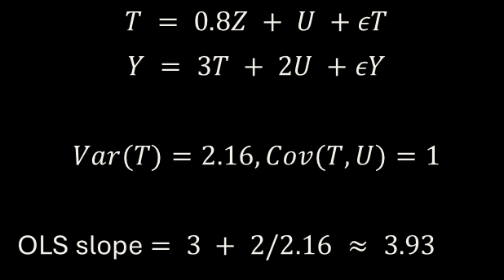
OLS and IV: What Should the Simulation Show?
Population OLS coefficient
Causal IV coefficient
$$T = 0.8Z + U +εT$$
$$Y = 3T + 2U +εY$$
$$Var(T)=2.16, Cov(T,U)=1$$
OLS slope $= 3 + 2/2.16 ≈ 3.93$
True treatment coefficient: 3.00
Instrument Z is independent of U and outcome noise.
2SLS targets 3.00 as sample size grows.
For actual estimates run coef(fit_ols)["T"] and coef(fit_iv)["T"] in R.

Slide 66
Add Baseline Covariates Correctly
R workflow
What to notice
# When baseline X is observed:
fit_iv_x <- ivreg(
Y ~ T + X | Z + X,
data = d_with_x
)
summary(fit_iv_x, diagnostics = TRUE)
Put exogenous covariates X on both sides of the IV formula.
This is a separate template requiring a dataset with X.

Slide 67
How to Interpret the R Output
OLS estimate
IV estimate
Precision
May be biased because U predicts both T and Y.
May be consistent under valid instrument and structural assumptions.
IV often has larger standard errors; design credibility still matters.
In the simulation, the data-generating treatment coefficient is 3.

Slide 68
Method Comparison: What Changes?
PSM / IPW / AIPW
Sensitivity analysis
Instrumental variables
Measured conditional exchangeability, plus positivity and consistency.
Assume a particular class/strength of hidden bias to assess robustness.
Relevance, independence, exclusion; monotonicity for binary-IV LATE.
Different methods answer different identification problems.

Slide 69
Lecture 10: Take-Home Messages
Hidden confounding
Sensitivity analysis
Instrumental variables
Flexible estimators alone cannot repair failure of exchangeability.
Quantifies how results change under specified unobserved bias.
Uses a new identifying strategy, often estimating LATE.
Next lecture: Difference-in-Differences and policy evaluation.

